Slide 1
A Simple Model For Star Formation
Amandeep Singh
BSc. (H) Physics
St. Stephen’s College

Slide 2
Aim
To work out a simple mathematical model for certain star formation regions.
To show the star forming regions as a dissipative structure on galactic scales in which spontaneous self-organization is realized in extreme non-equilibrium conditions.

Slide 3
Dissipative Structures
Thermodynamically open systems (exchange both energy and matter with surroundings) operating far from equilibrium
They settle in a more or less stable regime eventually in the form of limit cycles or stationary states.

Slide 4
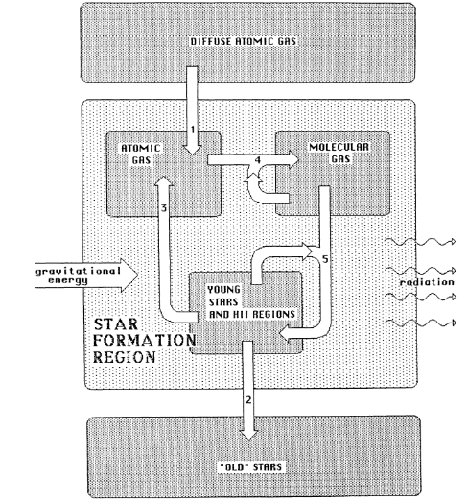
The Model

Slide 5
Component A
Cool, mostly neutral mono-atomic interstellar gas.
Primarily HI gas clouds, visible in 21 cm radio wavelength.
Can’t collapse to form young stars

Slide 6
Component M
Cool, mostly neutral molecular gas and dust.
A material that could collapse to form stars, due to efficient cooling mechanisms of dust and CO molecules. However, under unperturbed conditions, pressure equilibrium stabilizes the cloud and prevents further collapse.
When an external pressure is applied by the energetic events associated with the presence of young stars, a collapse sets in and new stars form

Slide 7
Component S
An incandescent component, consisting of young stars with their associated hot and ionized surrounding gas i.e. H(II) regions.
Includes active young stars that considerably perturb the interstellar medium by their emissions.

Slide 8
Infinite Reservoirs
One that ensures an unlimited supply of fresh cool atomic gas. We assume that all the matter that leaves the system under the form of old stars will be replenished by this reservoir.
A ‘waste’ reservoir that collects all the matter not taking part in the processes between the active components of the system. It includes the end products of stellar evolution which might be in the form of white dwarfs or neutron stars.

Slide 9
The Model

Slide 10
Equations
CONSERVATION OF MASS : T = A + M + S

Slide 11
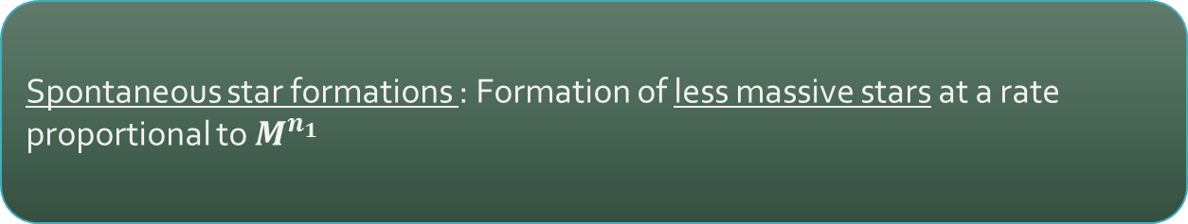
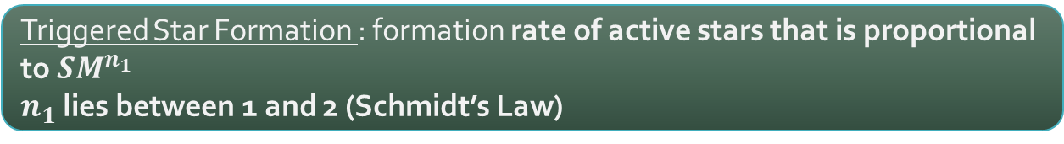
Interactions:
Star Formation
Triggered Star Formation : formation rate of active stars that is proportional to $SM^{n_{1}}$
$n_{1}$ lies between 1 and 2 (Schmidt’s Law)
Spontaneous star formations : Formation of less massive stars at a rate proportional to $M^{n_{1}}$

Slide 12
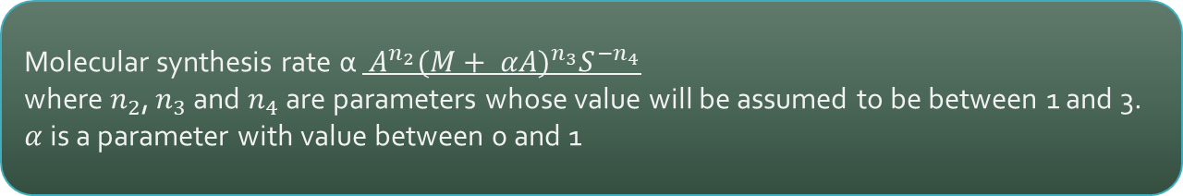
Molecular Synthesis
→ Gas phase reactions and dust catalyzed reactions → Incident dissociative radiation → Efficient cooling mechanisms in the cloud
Molecular synthesis rate α $A^{n_{2}}{(M+ αA)}^{n_{3}}S^{{−n}_{4}}$
where $n_{2}$, $n_{3}$ and $n_{4}$ are parameters whose value will be assumed to be between 1 and 3. $α$ is a parameter with value between 0 and 1

Slide 13
Atomic Cloud Component A:
Constant replenishment due to loss by stellar evolution
Increase due to amount fed by young stars in the form of stellar wind
Loss by Molecular synthesis
Increase due to loss in mass by Spontaneous star formation
$$\frac{dA}{dt}= K_{1}S+ K_{2}S+ K_{3}M^{n_{1}} − K_{4}A^{n_{2}}{(M+ αA)}^{n_{3}}S^{{−n}_{4}}$$

Slide 14
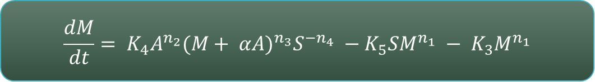
Molecular Cloud Component M:
Constant formation from molecular synthesis.
Loss by Triggered star formation
Loss by Spontaneous star formation
$$\frac{dM}{dt}= K_{4}A^{n_{2}}{(M+ αA)}^{n_{3}}S^{{−n}_{4}} −K_{5}SM^{n_{1}} − K_{3}M^{n_{1}}$$

Slide 15
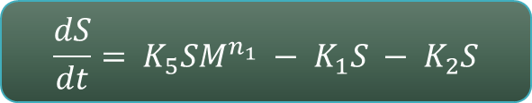
Stellar Component S:
Loss due to stellar evolution
Loss due to stellar winds
Increase due to Triggered star formation
$$\frac{dS}{dt}= K_{5}SM^{n_{1}} − K_{1}S − K_{2}S$$

Slide 16
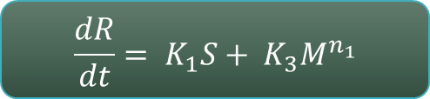
Waste Reservoir R:
Stars formed by spontaneous molecular cloud collapses (main sequence stars of low mass)
Mass deposited as a result of stellar evolution.
$$\frac{dR}{dt}= K_{1}S+ K_{3}M^{n_{1}}$$

Slide 17
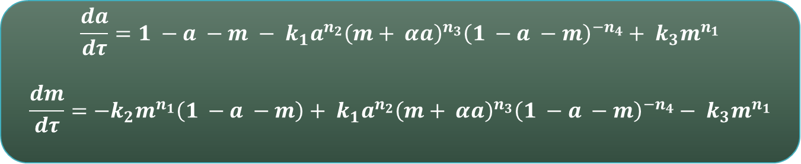

Final Reduced Equations:
$$\frac{da}{dτ}=1 −a −m − k_{1}a^{n_{2}}{\left(m+ αa\right)}^{n_{3}}{\left(1 −a −m\right)}^{{−n}_{4}}+ k_{3}m^{n_{1}}$$
$$\frac{dm}{dτ}=−k_{2}m^{n_{1}}\left(1 −a −m\right)+ k_{1}a^{n_{2}}{\left(m+ αa\right)}^{n_{3}}{\left(1 −a −m\right)}^{{−n}_{4}}− k_{3}m^{n_{1}}$$
Where:
$$a= \frac{A}{T}, m= \frac{M}{T}, τ=\left(K_{1}+ K_{2}\right)t$$
$$k_{1}= \frac{K_{4}T^{(n_{2}+ n_{3} − n_{4} −1)}}{K_{1} + K_{2}} , k_{2}= \frac{K_{5}T^{n_{1}}}{K_{1} + K_{2}} , k_{3}= \frac{K_{3}M^{n_{1} }}{K_{1} + K_{2}}$$

Slide 18
Possible Solutions Exhibited By The System:
→ Evolution towards a Stationary state
→ Evolution towards a Limit Cycle

Slide 19
Properties Of Solutions Obtained:
Evolution towards a stationary state
For certain combination of the parameters, the model evolves towards a stationary state; which initially starts with some periodic oscillations. These oscillations are then damped, and after a certain relaxation time, all variables (atomic, molecular and stellar content) reach constant values.
This means that all the interactions between the three components are still present, but in such a way that their combined effects cancel out.

Slide 20
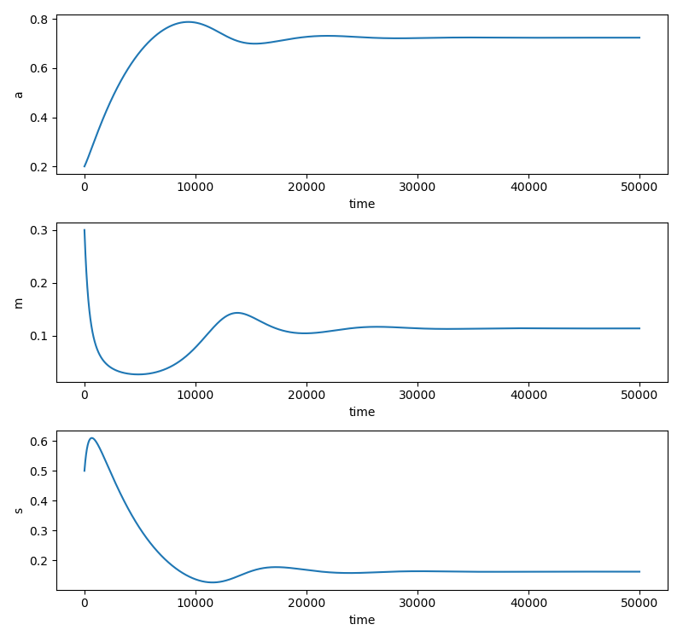

Parameters : $n_{1}$ = 1.8 $n_{2}$ = 1 $n_{3}$ = 3 $n_{4}$ = 1 $k_{1}$ = 5 $k_{2}$ = 50 $k_{3}$ = 0 α = 0.2
Initial Values :
$a_{0}$ = 0.2 $m_{0}$ = 0.3 $s_{0}$ = 0.5

Slide 21
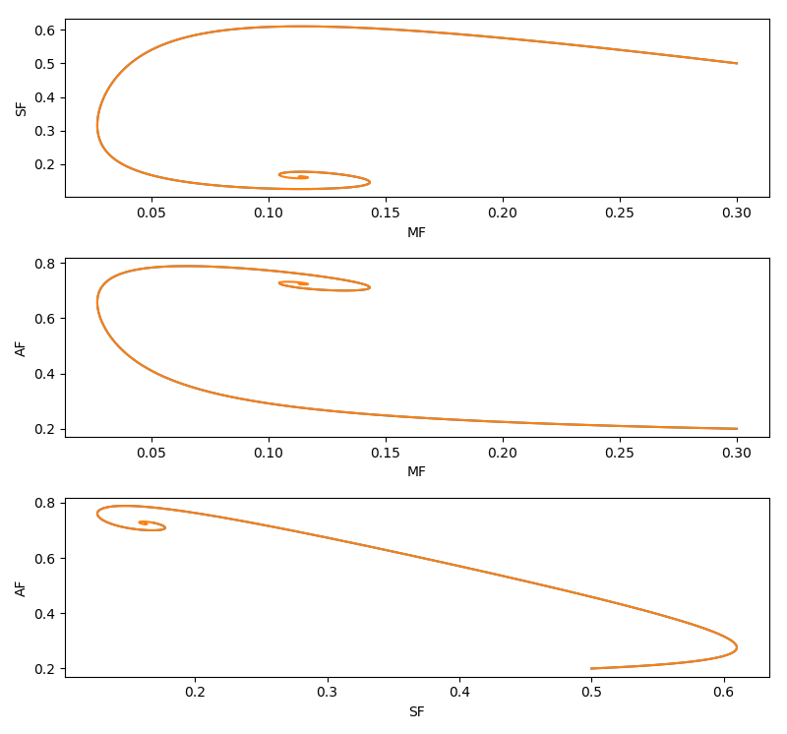

Slide 22
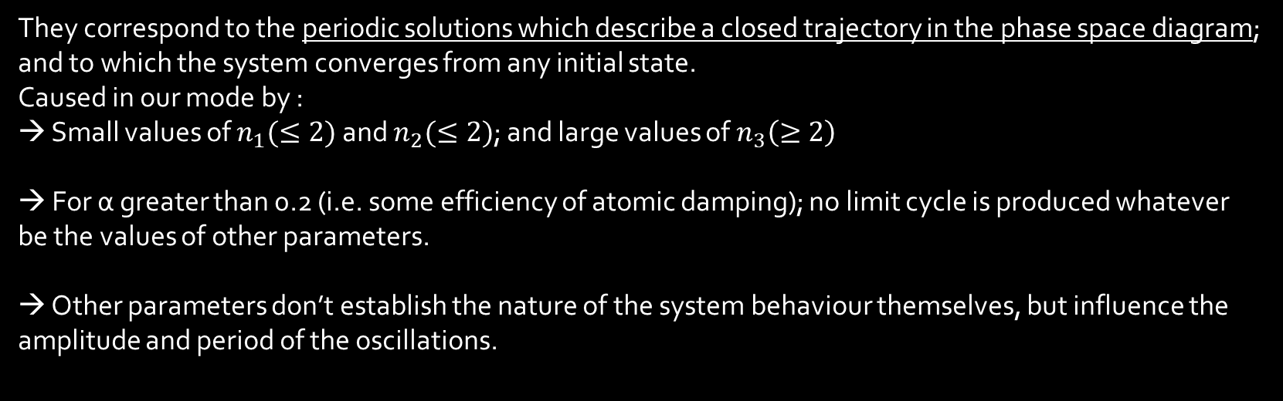
Limit Cycle Solutions
They correspond to the periodic solutions which describe a closed trajectory in the phase space diagram; and to which the system converges from any initial state. Caused in our mode by : → Small values of $n_{1}(≤2)$ and $n_{2}(≤2)$; and large values of $n_{3}\left(≥2\right)$
→ For α greater than 0.2 (i.e. some efficiency of atomic damping); no limit cycle is produced whatever be the values of other parameters.
→ Other parameters don’t establish the nature of the system behaviour themselves, but influence the amplitude and period of the oscillations.

Slide 23
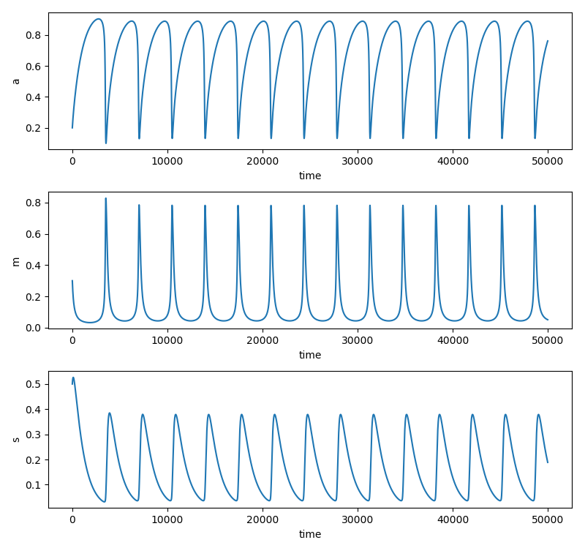

Type 1
Parameters : $n_{1}$ = 1.8 $n_{2}$ = 1 $n_{3}$ = 3 $n_{4}$ = 1 $k_{1}$ = 5 $k_{2}$ = 10 $k_{3}$ = 5 α = 0.05
Initial Values :
$a_{0}$ = 0.2 $m_{0}$ = 0.3 $s_{0}$ = 0.5

Slide 24
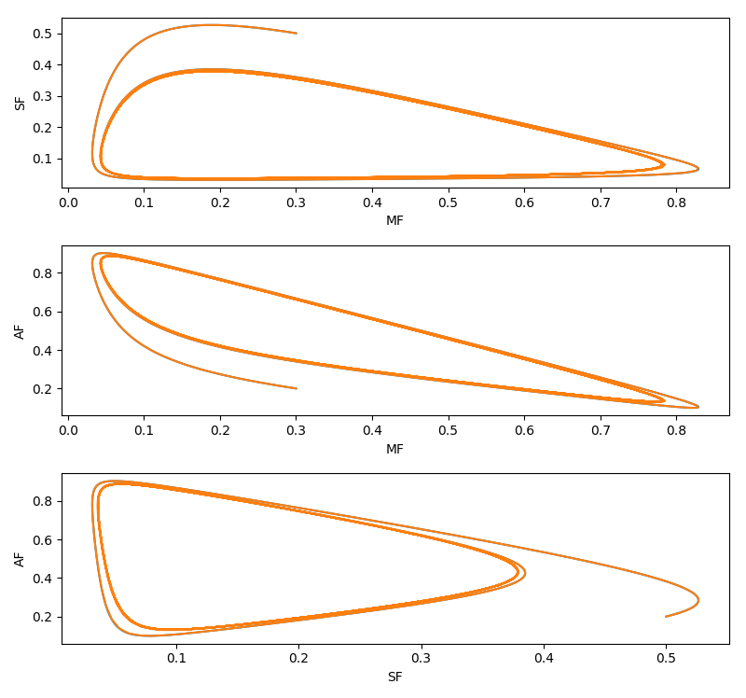

Slide 25
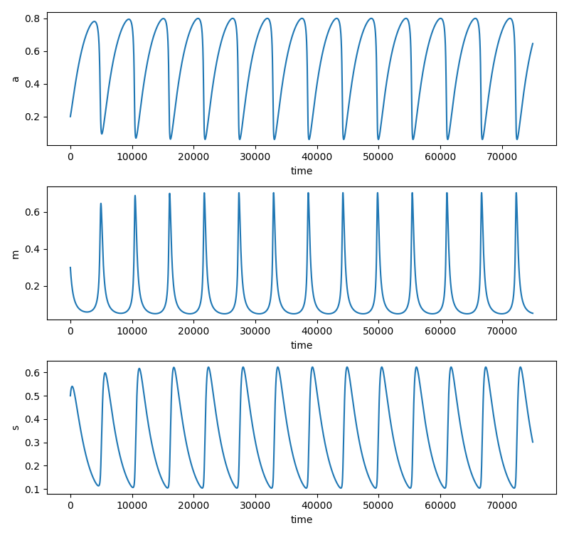

Type 2
Parameters : $n_{1}$ = 1.8 $n_{2}$ = 1 $n_{3}$ = 3 $n_{4}$ = 2.5 $k_{1}$ = 5 $k_{2}$ = 20 $k_{3}$ = 0 α = 0.05
Initial Values :
$a_{0}$ = 0.2 $m_{0}$ = 0.3 $s_{0}$ = 0.5

Slide 26
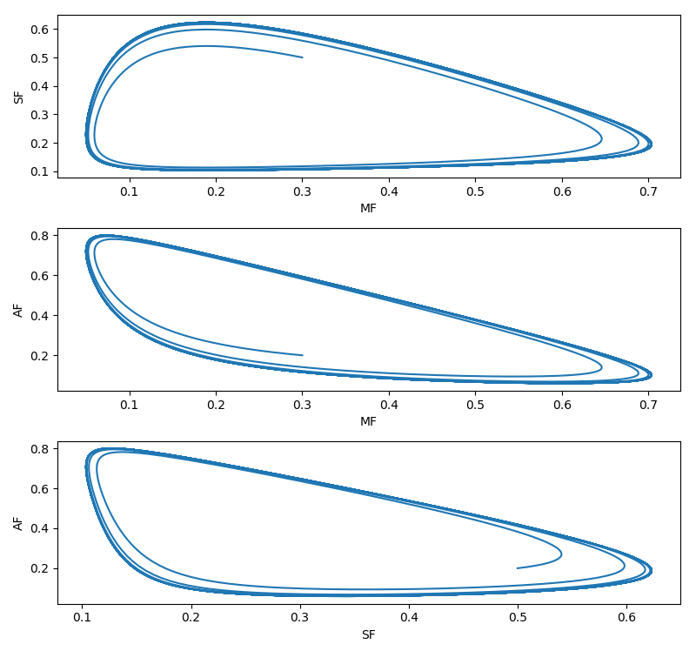

Slide 27
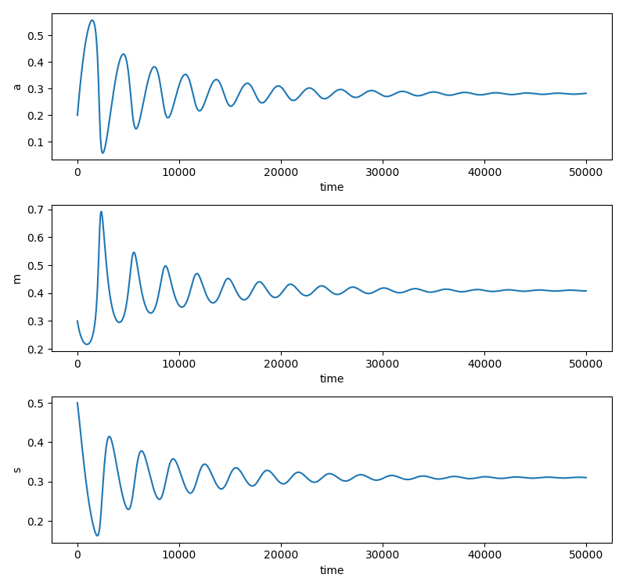

Type 3
Parameters : $n_{1}$ = 1.8 $n_{2}$ = 1 $n_{3}$ = 3 $n_{4}$ = 1 $k_{1}$ = 5 $k_{2}$ = 15 $k_{3}$ = 0 α = 2.5
Initial Values :
$a_{0}$ = 0.2 $m_{0}$ = 0.3 $s_{0}$ = 0.5

Slide 28
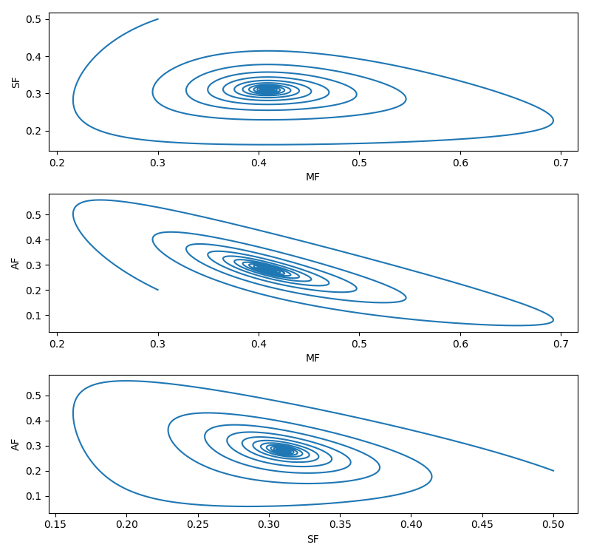

Slide 29
Observational Evidence:
Where can we observe such star formation phenomenon?
Various dwarf and small irregular galazxies due to the presence of relatively few and independent star forming regions. For eg : Burst-like star formations are observed in the recent times : eg, in IZw18, IZw36 and in M101 dwarfs
Molecular cloud complexes like W51 in the Sagittarius Arm : Active Sequential star formation site; associated with huge molecular cloud structures as well.

Slide 30
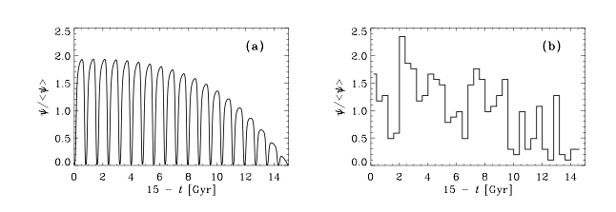
Observational Evidence:
(a) Limit cycle model for the Galactic Disk, time averaged to be consistent with observations. (b) Star Formation History derived observationally by Rocha-Pinto et al.(2000a)

Slide 31
Behavior Of The System:
Our Main Process
An irreversible transformation of atomic gas, mainly hydrogen and helium, into stellar end products.
Characteristics of the system
Open with respect to the universe.
Can’t reach equilibrium.
Driven by the fundamental force of nature : gravity

Slide 32
Result:
Expected
Gradual homogenization of the system, expected to go with the entropy increase associated with irreversible processes
Obtained
A progressively more discrete spatial distribution of cosmic matter is realized with time.

Slide 33
Analysis:
A three-component basic star-forming region, by itself, can impose self regulation by feedback control through autocatalysis. This stable self-sustaining behaviour with time results in an appearance of it being a temporal dissipative structure.
Such a system can outlive its individual components by huge periods of time.
Many such examples are found in nature : the simplest of them being a living organism!

Slide 34
References :
: Bodife, G., De Loore, 1985. Oscillations in star formation and contents of a molecular cloud complex. Astron. Astrophys. 142, 297.
: Bodife, G., 1986. Star formation regions as galactic dissipative structures. Astrophys. Space Sci. 122, 41. : Hiroyuki Hirashita, Berkert et al, 2001. Chemical evolution of the galaxy based on the oscillatory Star formation history.iopscience.iop.org : M.A.Sharaf, R.Ghoneim, 2013. A mathematical model of Star Formation in the Galaxy. Department of Astronomy, King Abdul Aziz University, Saudi Arabia : Wikipedia.com

